Slide 1
JavaScript
JS Objects

Slide 2
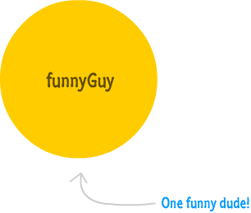
THE Object
the Object type that lays the groundwork for both custom objects as well as built-in types like Function, Array
everything except null and undefined are directly related to an Object or can become one as needed.
Creating Objects
var funnyGuy = {};

Slide 3
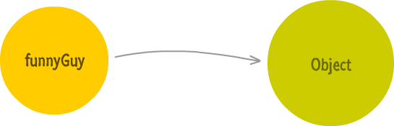
BEHIND THE SCENES
Because ‘funnyGuy’ is an object, is has a connection to the main Object type that it derives from

Slide 4
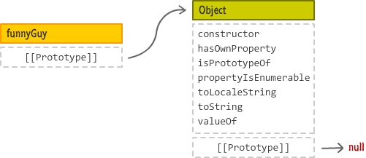
Delving deeper….
funnyGuy object has no properties defined except a special internal property that exists called __proto__ and often represented as [[Prototype]]
This [[Prototype]] property points to our Object

Slide 5
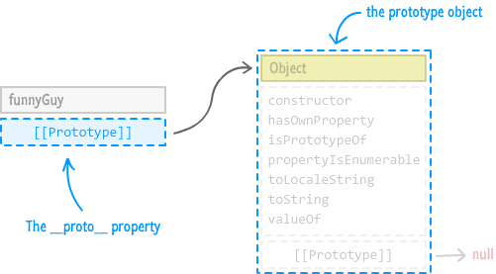
…AND DEEPER
The [[Prototype]] property references is what is known as a prototype object (equivalent to the parent object/super class for OO folks out there)
Example
var funnyGuy = {};
funnyGuy.toString(); // [object Object]

Slide 6
Prototype chain
Prototype Chain. If an object doesn't have what you are looking for, the JavaScript engine will navigate to the next object as determined by the [[Prototype]] property and keep going until it reaches the very end. The very end is when you try to access the [[Prototype]]property on the Object itself. You can't go any further beyond Object, since that is as basic of a type as you can get.

Slide 7
ADDING PROPERTIES TO OBJECTS
Dot notataion
Square bracket syntax
Object initializer with literal notation

Slide 8
ADDING METHODS TO OBJECTS – AN EXAMPLE
var funnyGuy = {
firstName: "Conan",
lastName: "O'Brien",
getName: function() {
return "Name is: " + this.firstName + " " + this.lastName;
}
};
alert(funnyGuy.getName()); // displays "Name is Conan O'Brien"

